Slide 1



Implementing AI-Powered Content Management Pipelines for Infolep and InfoNTD Knowledge Platforms
Hubert Perliński

Slide 2

The challenge of staying up to date
1.5 million
new
entries anually
Inadequate seraching tools
Large noise to signal ratio

Slide 3


The challenge of staying up to date
1.5 million
new
entries anually
Inadequate seraching tools
Large noise to signal ratio
Domain-specific curated knowledge platforms

Slide 4
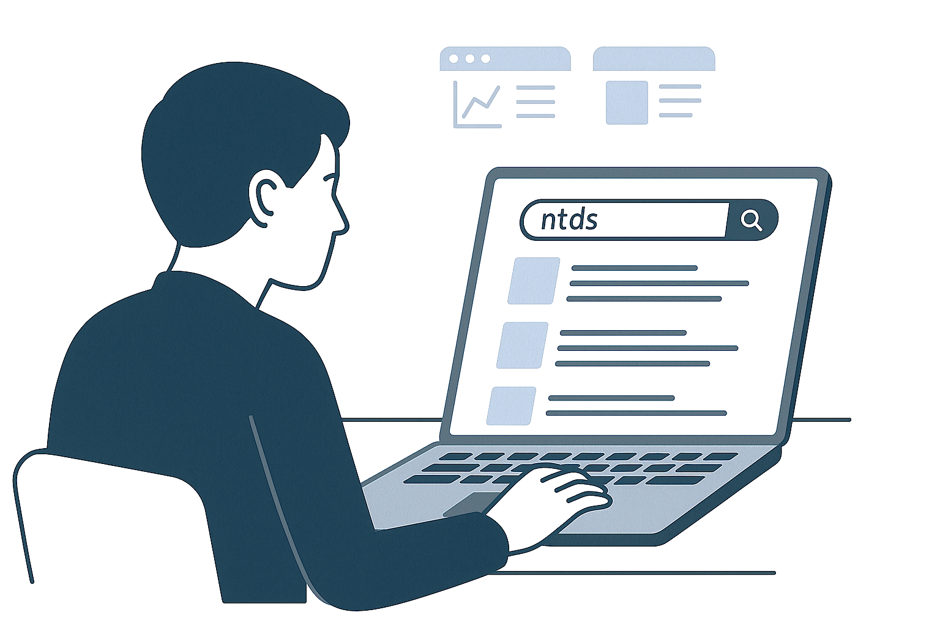
Content curation is labour intensive
Could AI-based methods be applied to support the content management needs of the Info Platforms?
Background
Experiment set-up
Results
Tools made for Info Platforms

Slide 5
Content curation is labour intensive
Could AI-based methods be applied to support the content management needs of the Info Platforms?
Background
Experiment set-up
Results
Tools made for Info Platforms

Slide 6
Many studies, few deployments
Traditional ML
SVMs, RFs, XGBoost
Bag of words vectors
Transformers
Biomedical publications classification
BERT, BioBERT, SciBERT
Fine-tuning
Large Language Models
GPTs, Gemini, LLaMA
Zero-shot classification
Hybrid approaches
Ensembling, preprocessing,
prioritizing

Slide 7
Many studies, few deployments
Traditional ML
SVMs, RFs, XGBoost
Bag of words vectors
Transformers
11.7k
papers added per month
at peak activity
Biomedical publications classification
BERT, BioBERT, SciBERT
Fine-tuning
Large Language Models
Scanning all of PubMed daily
8 topics
GPTs, Gemini, LLaMA
Zero-shot classification
Hybrid approaches
Ensembling, preprocessing,
prioritizing
Chen et al. 2019, 2020, 2021,2022, 2025

Slide 8
Adapt to Info Platforms Context
Inclusion task: Is the publication about NTDs?
Disease task: Which out of the 19 NTDs is the publication about?

Slide 9
Adapt to Info Platforms Context
Inclusion task: Is the publication about NTDs?
Disease task: Which out of the 19 NTDs is the publication about?
RQ1: How could robust datasets be constrcuted for classifying NTD literature?
RQ2: How do different model types perform on the tasks?
RQ3: What are the error patterns?
RQ4: How can the pipelines be integrated into a practical workflow?

Slide 10
RQ1: Hybrid data acquisition strategy
Info Platforms Data Export
PubMed 2025 Annual Baseline
Infolep and InfoNTD backend April 2025
39,070 unique publication with disease annotations
23,737 (61%) include abstracts
XML with all PubMed records until January 2025
36.5 unique million publications
25.3 million (69%) include abstracts
Contains MeSH terms (topic annotations)

Slide 11
RQ1: Hybrid data acquisition strategy
Info Platforms Data Export
PubMed 2025 Annual Baseline
Info Platforms processed
PubMed 250k sample
PubMed 400k sample
PubMed NTD Mesh Terms

Slide 12
RQ1: Hybrid data acquisition strategy
Info Platforms Data Export
PubMed 2025 Annual Baseline
Info Platforms processed
PubMed 250k sample
PubMed 400k sample
PubMed NTD Mesh Terms
250k abstracts
400k mixed
Info Platforms disease
Combined disease
Inclusion task
Disease task

Slide 13
RQ1: Hybrid data acquisition strategy
Info Platforms Data Export
PubMed 2025 Annual Baseline
Info Platforms processed
PubMed 250k sample
PubMed 400k sample
PubMed NTD Mesh Terms
250k abstracts
400k mixed
Info Platforms disease
Combined disease
Inclusion task
Disease task

Slide 14
RQ1: Hybrid data acquisition strategy
Info Platforms Data Export
PubMed 2025 Annual Baseline
Info Platforms processed
PubMed 250k sample
PubMed 400k sample
PubMed NTD Mesh Terms
250k abstracts
400k mixed
Info Platforms disease
Combined disease
Inclusion task
Disease task

Slide 15
RQ1: Hybrid data acquisition strategy
Info Platforms Data Export
PubMed 2025 Annual Baseline
Info Platforms processed
PubMed 250k sample
PubMed 400k sample
PubMed NTD Mesh Terms
250k abstracts
400k mixed
Info Platforms disease
Combined disease
Inclusion task
Disease task

Slide 16
RQ1: Hybrid data acquisition strategy
Info Platforms Data Export
PubMed 2025 Annual Baseline
Info Platforms processed
PubMed 250k sample
PubMed 400k sample
PubMed NTD Mesh Terms
250k abstracts
400k mixed
Info Platforms disease
Combined disease
Inclusion task
Disease task
80/20 train test splits; 10% of train for validation in relevant models
Quite large datasets – in literature rarely above 10k entries (except LitCovid)
Adding MeSH terms in Combined disease set had huge impact on underrepresented classes:
E.g. Zika Virus from 98 entries to 6k; Total size from 21k to 83k

Slide 17
Experiment pipelines
Support Vector Machines
BERT
Gemini 2.0 Flash
Ensemble

Slide 18
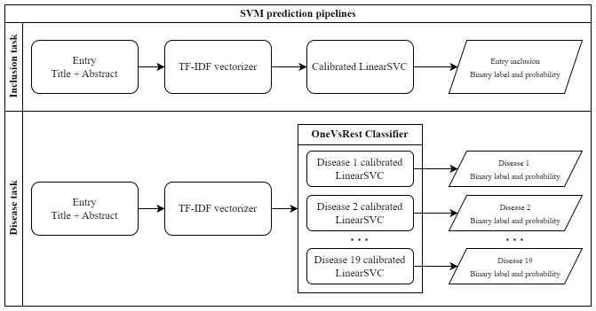
Experiment pipelines
Support Vector Machines
BERT
Gemini 2.0 Flash
Ensemble
Simple and fast
Often used as a baseline in literature
No contextual understanding

Slide 19
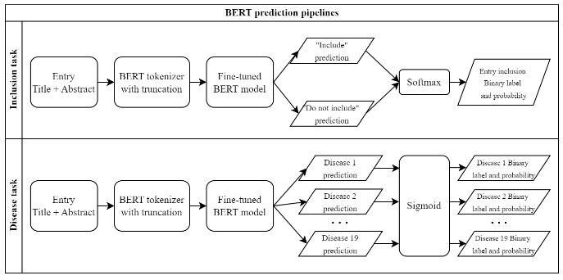
Experiment pipelines
Support Vector Machines
BERT
Gemini 2.0 Flash
Ensemble
Base model
Shown to improve performance
Contextual understanding
Ran locally, but with higher compute requirements

Slide 20
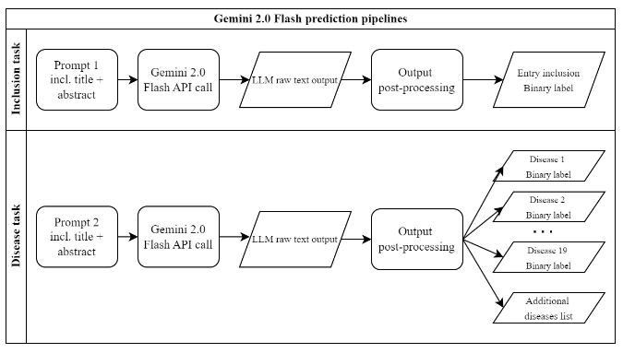
Experiment pipelines
Support Vector Machines
BERT
Gemini 2.0 Flash
Ensemble
No training required – easy to add diseases to the list
Advanced understanding
Smaller LLM
Requires post-processing

Slide 21


Experiment pipelines
Support Vector Machines
BERT
Gemini 2.0 Flash
Ensemble
Only in the disease classification
Combining three models
Tested:
Prediction union = any model identifies a disease
Majority voting = 2 out of 3 agree

Slide 22
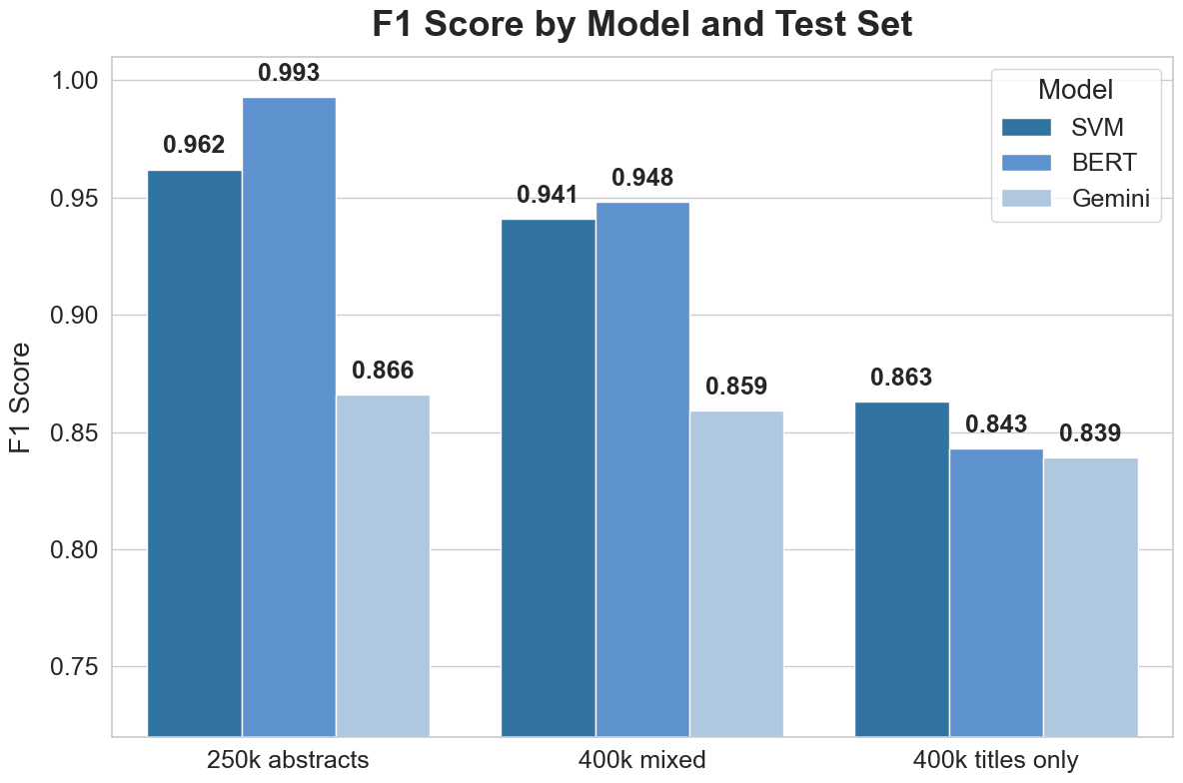

RQ2: Inclusion task results
All models performed well

Slide 23
RQ2: Inclusion task results
All models performed well
Abstract important, but good score still possible without it

Slide 24
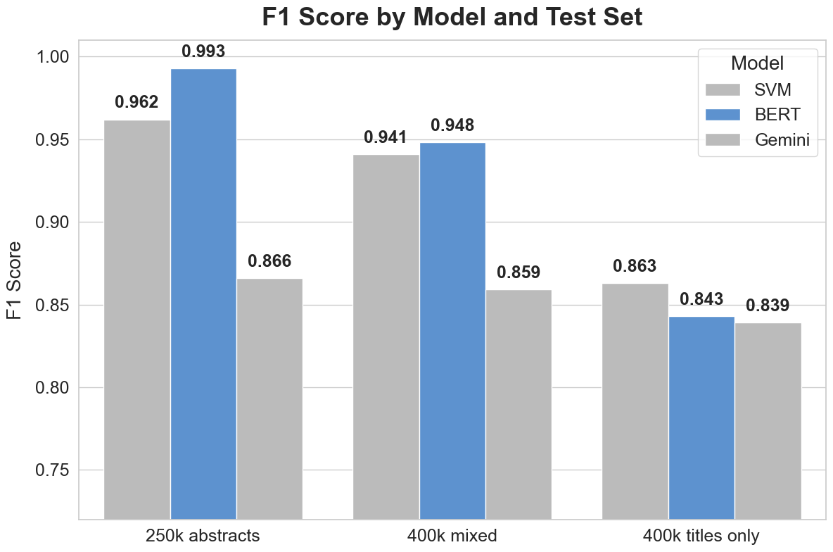
RQ2: Inclusion task results
All models performed well
Abstract important, but good score still possible without it
BERT best overall; small margin

Slide 25
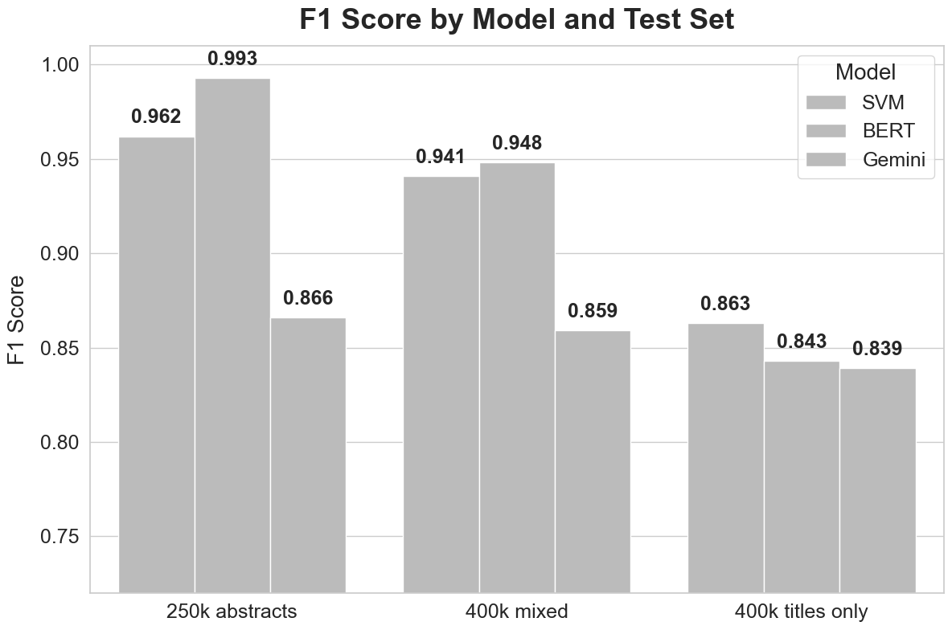
RQ2: Inclusion task results
All models performed well
Abstract important, but good score still possible without it
BERT best overall; small margin
SVM good on titles only

Slide 26
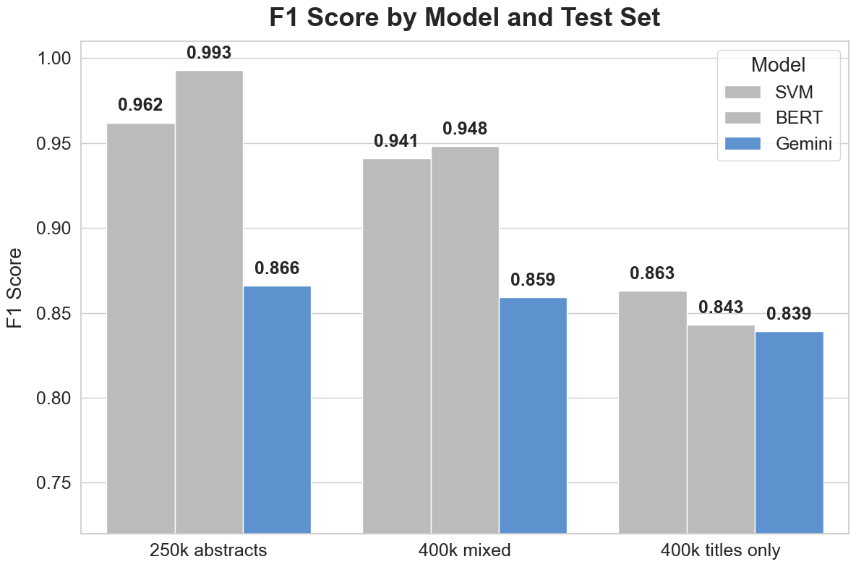
RQ2: Inclusion task results
All models performed well
Abstract important, but good score still possible without it
BERT best overall; small margin
SVM good on titles only
Gemini significantly worse; driven by recall

Slide 27
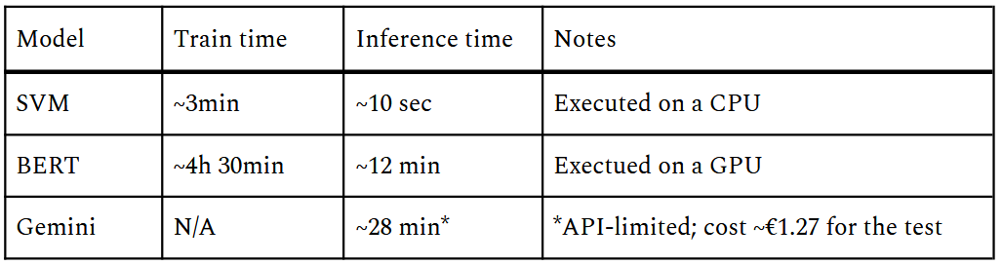
RQ2: Inclusion task results
All models performed well
Abstract important, but good score still possible without it
BERT best overall; small margin
SVM good on titles only
Gemini significantly worse; driven by recall
SVM most resource efficient

Slide 28
RQ2: Inclusion task results
RQ3: Failure modes:
Label errors in the data (both sources)
Impossible classification – full text needed
SVMs: diseases with similar symptoms to NTDs
Gemini: unclear NTD definition? - prompting
All models performed well
Abstract important, but good score still possible without it
BERT best overall; small margin
SVM good on titles only
Gemini significantly worse; driven by recall
SVM most resource efficient

Slide 29
RQ2: Inclusion task results
RQ3: Failure modes:
Label errors in the data (both sources)
Impossible classification – full text needed
SVMs: diseases with similar symptoms to NTDs
Gemini: unclear NTD definition? - prompting
All models performed well
SVM good on titles only
Abstract important, but good score still possible without it
Gemini significantly worse; driven by recall
BERT best overall; small margin
SVM most resource efficient
AI can help in finding content for Info Platforms
In practice SVMs preferred
BERT for best classification

Slide 30
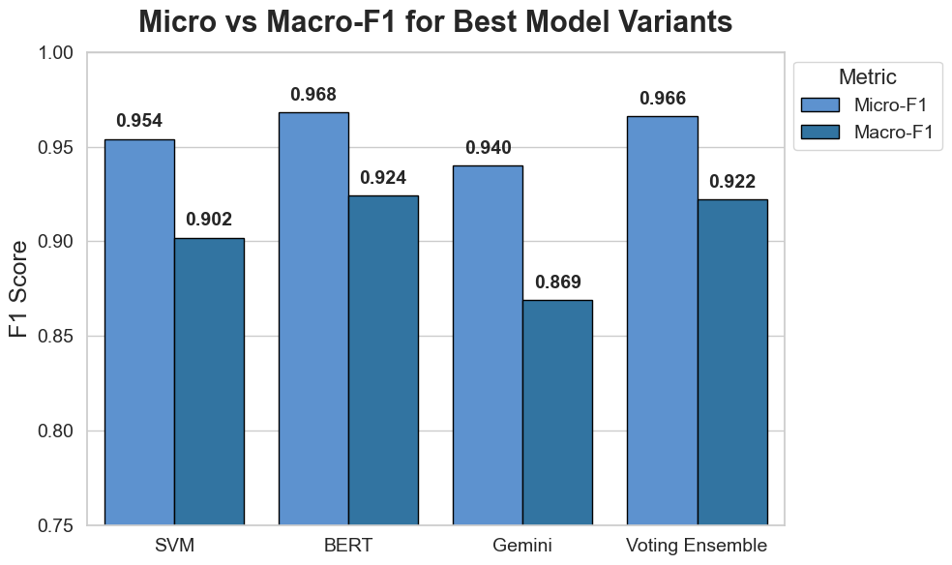
RQ2: Disease task results
Micro F1 = weighted by # samples in a disease
Macro F1 = all diseases same weight
All models performed very well

Slide 31
RQ2: Disease task results
Micro F1 = weighted by # samples in a disease
Macro F1 = all diseases same weight
All models performed very well
More samples = better results

Slide 32
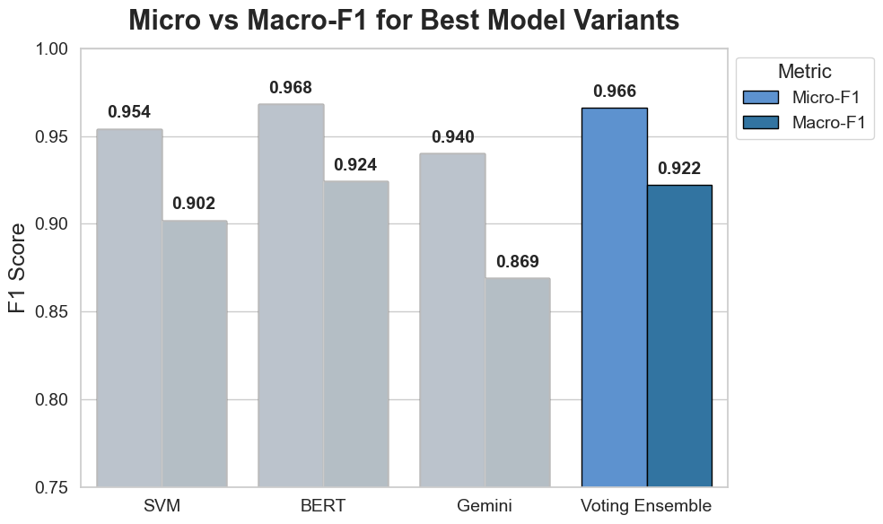
RQ2: Disease task results
Micro F1 = weighted by # samples in a disease
Macro F1 = all diseases same weight
All models performed very well
More samples = better results
Non-complementary errors

Slide 33
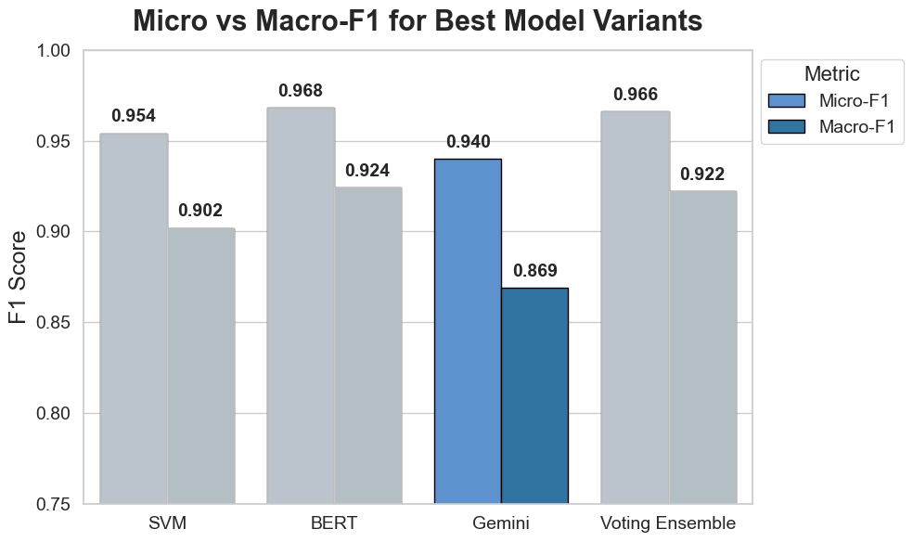
RQ2: Disease task results
Micro F1 = weighted by # samples in a disease
Macro F1 = all diseases same weight
All models performed very well
More samples = better results
Non-complementary errors
Gemini closer in performence

Slide 34
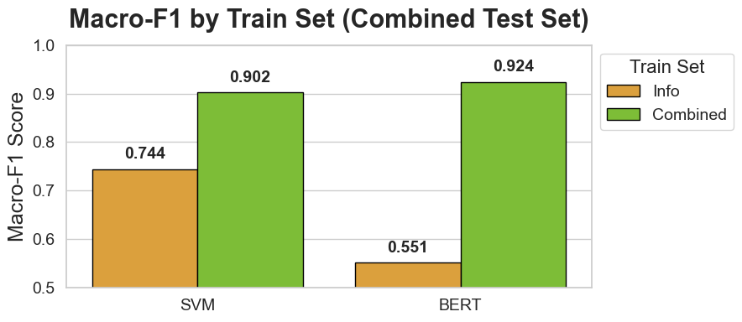
RQ2: Disease task results
Micro F1 = weighted by # samples in a disease
Macro F1 = all diseases same weight
All models performed very well
More samples = better results
Non-complementary errors
Gemini closer in performence
Large data needed

Slide 35
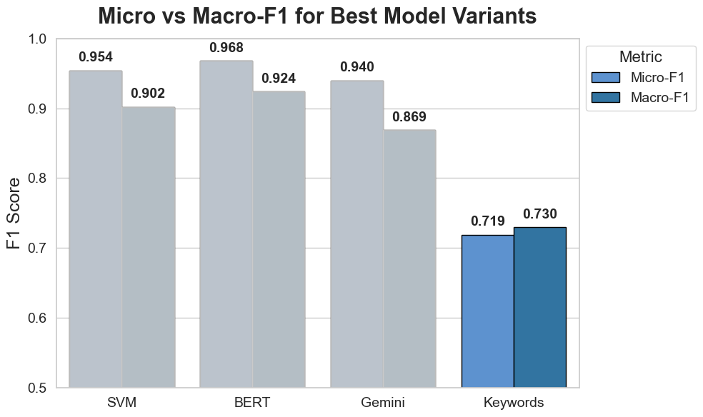
RQ2: Disease task results
Micro F1 = weighted by # samples in a disease
Macro F1 = all diseases same weight
All models performed very well
More samples = better results
Non-complementary errors
Gemini closer in performence
Large data needed
Better than keyword search

Slide 36
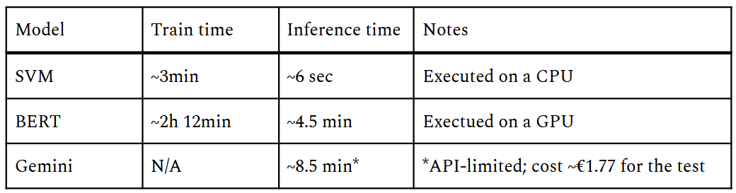
RQ2: Disease task results
Micro F1 = weighted by # samples in a disease
Macro F1 = all diseases same weight
All models performed very well
More samples = better results
Non-complementary errors
Gemini closer in performence
Large data needed
Better than keyword search
SVMs most efficient, Gemini close

Slide 37
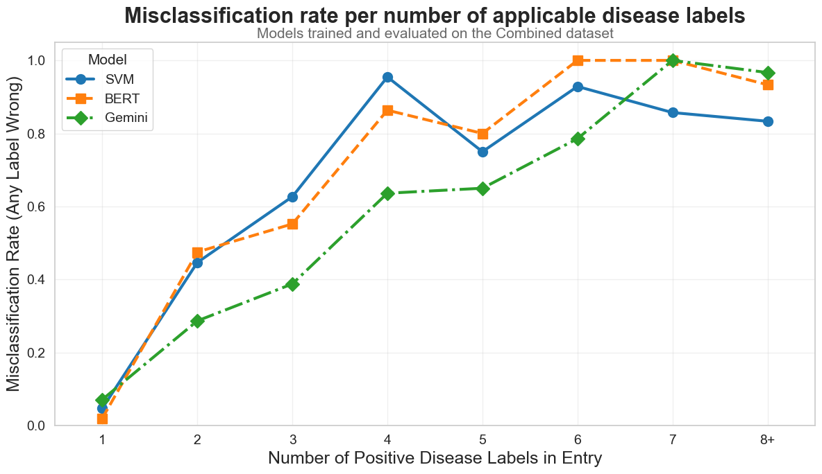
RQ2: Disease task results
RQ3: Misclassifications
All models performed very well
More samples = better results
Non-complementary errors
Gemini closer in performence
Large data needed
Better than keyword search
SVMs most efficient, Gemini close
More labels = harder task

Slide 38
RQ2: Disease task results
RQ3: Misclassifications
Failure modes:
4 outstanding diseases
Usually cases of multiple labels
Lymphatic filariasis and podoconiosis confusion
Data was the driver, not models
All models performed very well
More samples = better results
(dracunculiasis, lymphatic filariasis, podoconiosis, and yaws)
Non-complementary errors
Gemini closer in performence
Large data needed
Better than keyword search
SVMs most efficient, Gemini close
More labels = harder task

Slide 39
RQ2: Disease task results
RQ3: Misclassifications
Failure modes:
4 outstanding diseases
Smaller sample = larger impact
Usually cases of multiple labels
Lymphatic filariasis and podoconiosis confusion
Data was the driver, not models
All models performed very well
Large data needed
More samples = better results
Better than keyword search
Non-complementary errors
SVMs most efficient, Gemini close
Gemini closer in performence
More labels = harder task
AI can identify the diseases very well
In practice SVMs preferred
Gemini 2.0 Flash for simple taxonomy adjustments

Slide 40
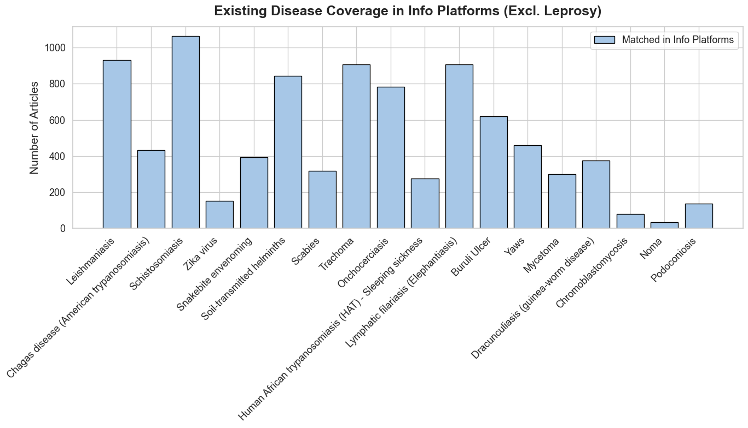
PubMed historical data analysis

Slide 41
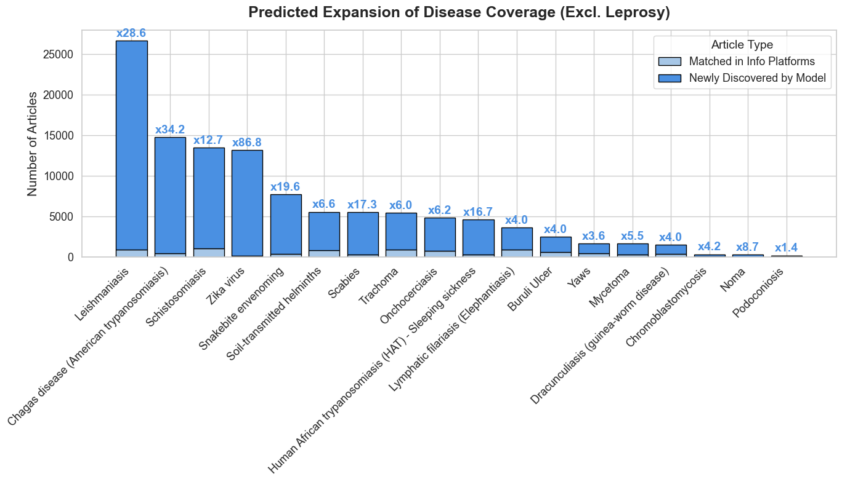
PubMed historical data analysis
162k
New publications
92%
Recall
With prob. threshold 0.5

Slide 42
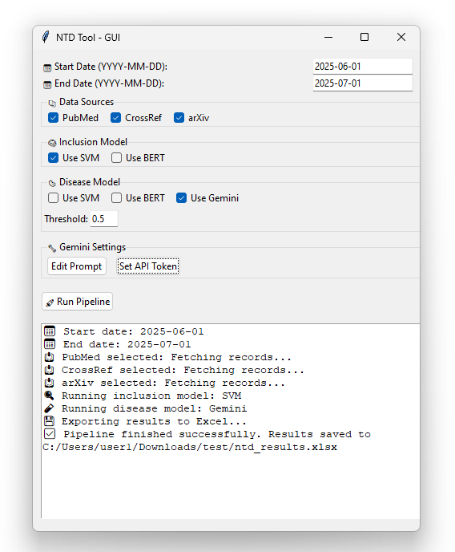
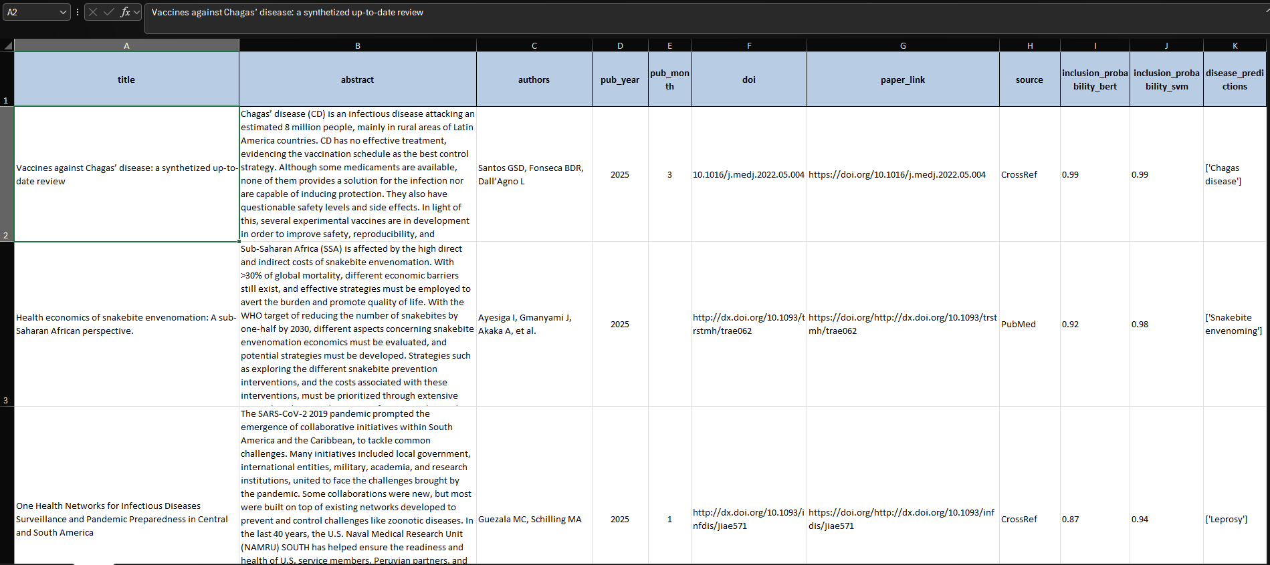
RQ4: Proof of concept tool

Slide 43
Limitations & Future research
Training on abstracts
More complex tags
MeSH reliance
Separate multi-disease label
English dominance
Broader publication types
News, courses

Slide 44
Conclusions
Datasets / experiments
AI-Powered Content Management Pipelines definetly can support the operations of Info Platforms
Historical data scan + proof of concept

Slide 45

The enablers of the project

